Slide 1
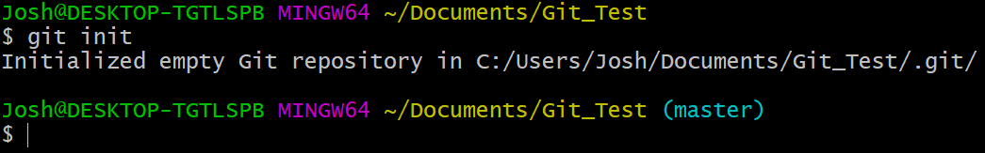
Using Git
Git Bash/Terminal
Creating a repository
Basic Commands
git init
cd – Changes directory by typing desired directory after cd.
Use cd to change directory to the desired repository location and enter “git init”
cd Documents/
ls – Lists all items in current directory
This will setup up the structure and files needed for your repository to function
clear – Clears the command prompt
The directory will show (master) after creation

Slide 2
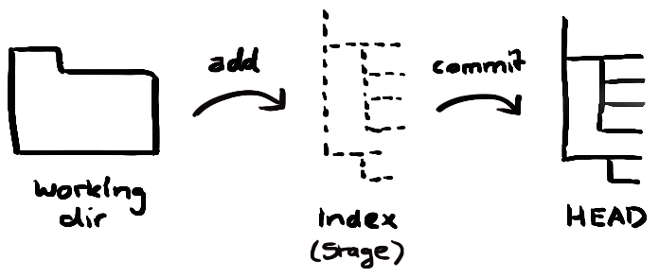
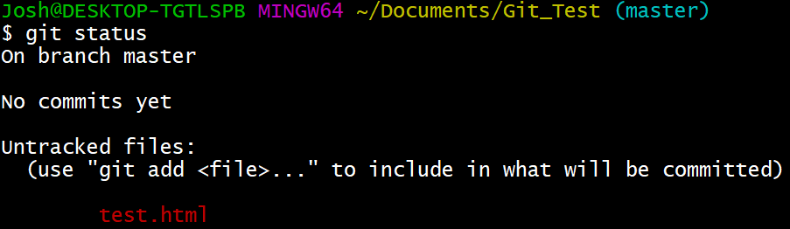
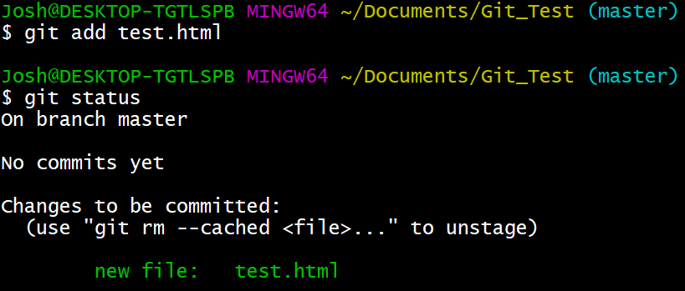
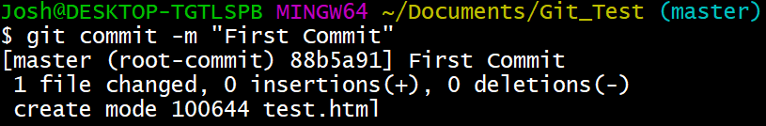
git status
Shows tracked/untracked
or modified/deleted files
Adding files to Stage/Index
Committing files to HEAD
git add <filename>
git commit –m “commit message”
Adds files to index or updates modified files
Commits files from Index/Stage and logs the commit
\
Adds all new files or modified files
git add *

Slide 3
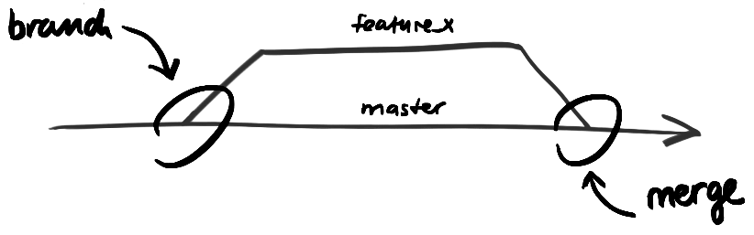
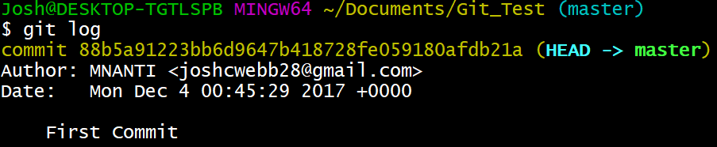

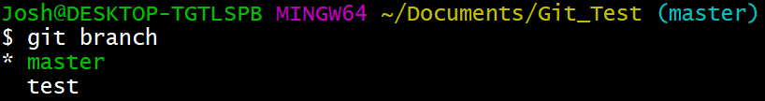
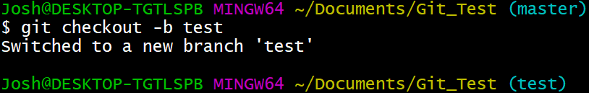
git log
Shows previous commits
Commit hash
Changing commit/branch
Viewing branches
git checkout
git branch
By entering the branch name or commit hash after “git checkout” you can access other commits or branches
Creating a new branch
Merging branches
git checkout –b <branch name>
git merge <branch>
Merges the named branch to the currently active branch

